Slide 1

PARKnSHOP.com Online Mall B2C E-Commerce

Slide 2
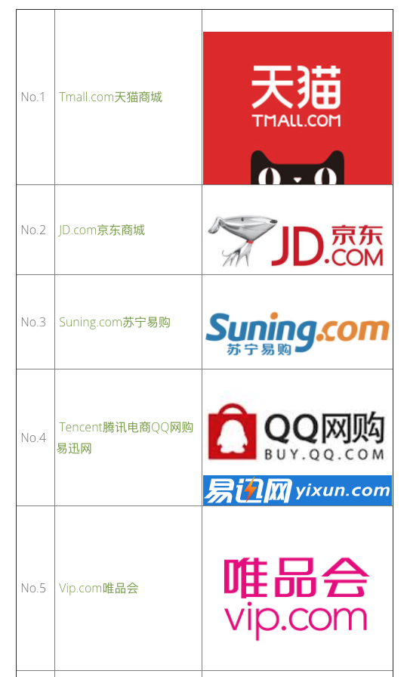
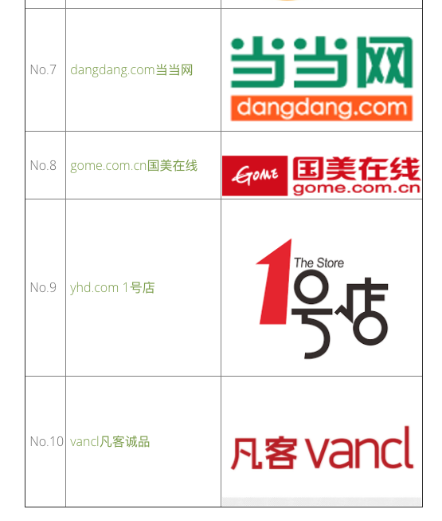

Slide 3
Project Description
The PARKnSHOP.com Online Mall application enables vendors to set up online shops, customers to browse through the shops, and a system administrator to approve and reject requests for new shops and maintain lists of shop categories.
Also on the agenda is designing an online shopping site in English to manage the items in the shop and also help customers purchase them online without having to visit the shop physically.
PARKnSHOP.com Online Mall will use the internet as the sole method for selling goods to its consumers. The consumer will be in complete control of his/her shopping experience. Shopping will be highly personalized and the mall will provide lower prices than most competitors. This, in brief, is a description of our product which will showcase a complete shopping experience in a small package.

Slide 4
Project Stakeholder
Sponsor – ParknShop (hongKong), Company from HongKong.
Project Sponsor (Mr.AJ)
You have to complete the project for ParknShop in 7 Weeks with english UI.
Show a Demo of the Project to Sponsor

Slide 5
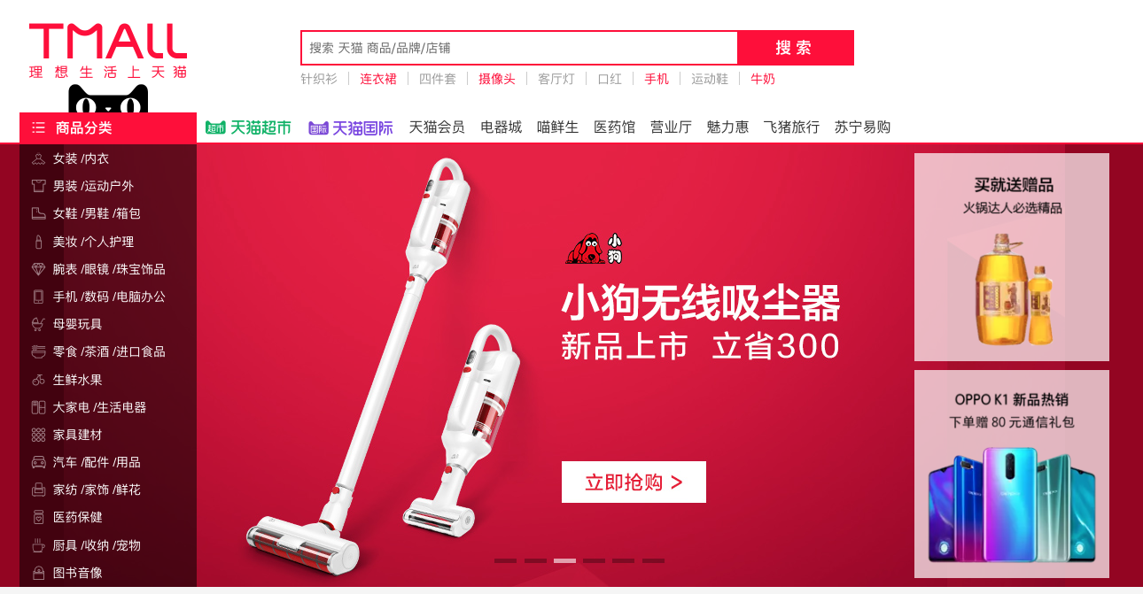
Project Description
The PARKnSHOP.com Online Mall application income
Sales commission (2%) every sale from Shop 2 Customer.
Advertisement Revenues paid to ParknShop from the Shop Owner.
Advertisement Category | Rate /Daily
Price Store Listing , 5Shops | 500 RMB
Product Listing – 10 Products | 1000RMB

Slide 6
PARKnSHOP.com Online Mall: Product Categories
TV& Home Theater
Computers & Tablets
Cell Phones
Cameras & Camcorders
Audio
Car Electronics & GPS
Video, Games, Movies & Music
Health, Fitness & Sports
Home & Office

Slide 7
PARKnSHOP.com Online Mall: Target Users
Mall Guests
Mall Administrator
Shop Owner{Seller}
Mall Customer{Buyer}

Slide 8
PARKnSHOP.com Online Store: Project Scope
Mall Guest
Register
Name /Telephone /Address
Search Product
View Product Page

Slide 9
PARKnSHOP.com Online Mall: Project Scope
Mall Administrator
Login
Manage Shop Owner ( 1 Shop Owner only 1 Shop)
Approve OR Reject New Shop Owner request
Search Shop Owner or Shop
Blacklist(黑名单) Shop Owner(Suspended) or Shop
Delete Shop Owner or Shop
Manage Customer
Search Customer
Blacklist(黑名单) Customer (Suspended)
Delete Customer
Manage Advertisement
Top 10 Products
Top 5 Stores
Backup Database - Daily
View Sales History (Daily /Weekly/ Monthly/ Yearly)
Calculate PARKnSHOP.com Income from Sales Commission (2%)
Daily /Weekly/ Monthly/ Yearly
Manage Commission
Modify Commission Rates
Search Order by OrderID

Slide 10
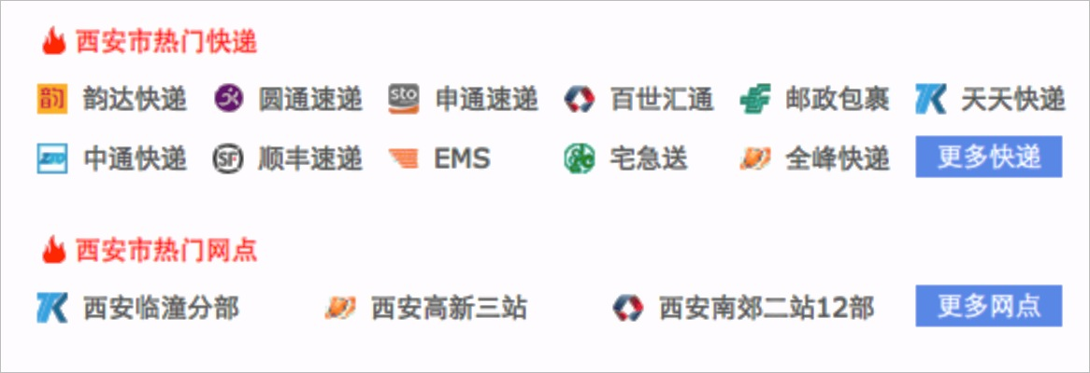
PARKnSHOP.com Online Mall: Project Scope
Shop Owner{Seller}
Register New Shop (Wait Administrator Approve for activation)
Login
Manage Products
Add /Modify / Delete Products ( upload Photo’s Product)
Manage Advertisement
Apply Advertisement
Homepage Product list
Add/Modify Shop Details
Shop contacts / Email / Telephone
Manage Order
Processing Order -> Preparing for Shipment->Shipped->Complete
View Sales History (Daily /Weekly/ Monthly/ Yearly)- Search
View Shop Income from Sale
Daily /Weekly /Monthly /Yearly

Slide 11
PARKnSHOP.com Online Mall: Project Scope
Mall Customer
Register
Name /Telephone /Address
Login
Search Product
View Product Page
Add Cart
Add Favorite
Add Favorite Shop or Product
Add cart
Delete Product from Cart
Modify Product Quantity
Buy
Pay ( Interface to bank system) via Alipay or Wechat
Order Details
Order Status (Processing Order -> Preparing for Shipment->Shipped->Complete)
Comment Product (Only Purchased)
View Buy History (Daily /Weekly/ Monthly/ Yearly)- Search

Slide 12
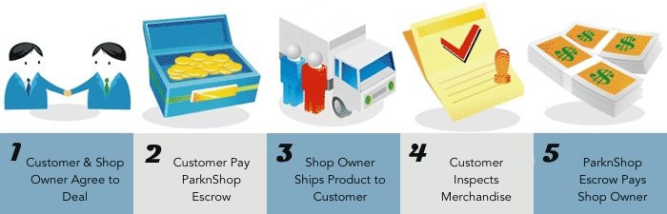
PARKnSHOP.com Online Mall: Project Scope
中介

Slide 13
Project:PARKnSHOP.com Online Mall
Week1 | Week2 | Week3 | Week4 | Week5 | Week6 | Week7 | Week8
Req: Design: |  |  |  |  |  |  | Project Demo
 | Release 1 |  | Release 2 |  | Release 3

Slide 14
Scrum Framework
(Software Development)
1-2 Weeks

Slide 15
Team Work
Finalize the Requirement, Software Architecture, Technology and Database Design before starting first sprint.

Slide 16




Project Sponsor
Mr.AJ
Finalize (DB,SA)
PM(1)
Team Leader(TL1)
Customer Module
Team Leader(TL2)
Shop Owner Module
Team Leader(TL3)
Administrator Module
Design, Code, Test
Design, Code, Test
Design, Code, Test

Slide 17
Project: PARKnSHOP.com Online Mall
Week1 | Week2 | Week3 | Week4 | Week5 | Week6 | Week7 | Week8
Req: Design: |  |  |  |  |  |  | Project Demo
 | Work For Release 1 |  | Work For Release 2 |  | Work For Release 3
 | Customer Shop Owner Administrator |  | Customer Shop Owner Administrator |  | Customer Shop Owner Administrator
End of Week3,
Release 1
End of Week5,
Release 2
End of Week7,
Release 3

Slide 18
Project Demo:2019/01/08

